Slide 1



CellDesigner in Action: A Workshop on Systems Biology Modeling
Dr. Arathi G.R.
Research Scientist
AMRITA
amrita.edu/mindbrain

Slide 2
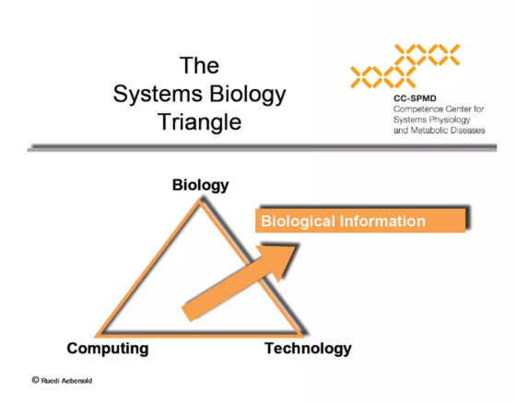


Overview
AMRITA
Installation Procedures
Introduction to cell designer
SBML (Systems Biology Markup Language)
SBGN (Systems Biology Graphical Notations)

Slide 3
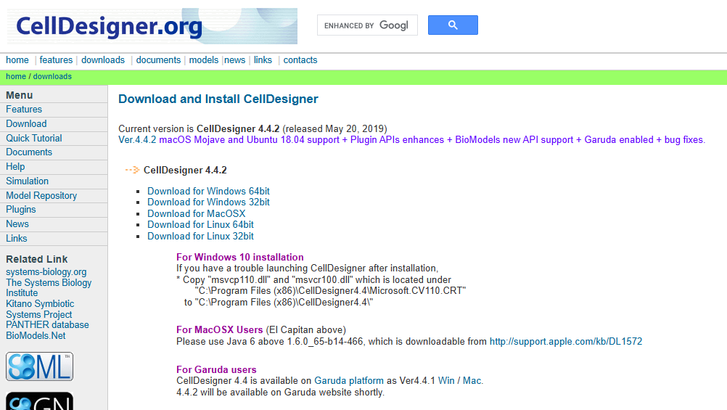
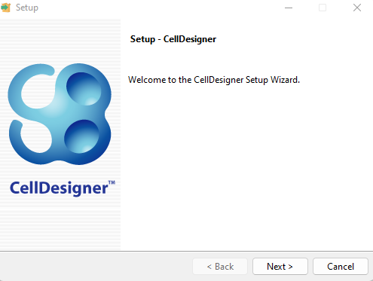
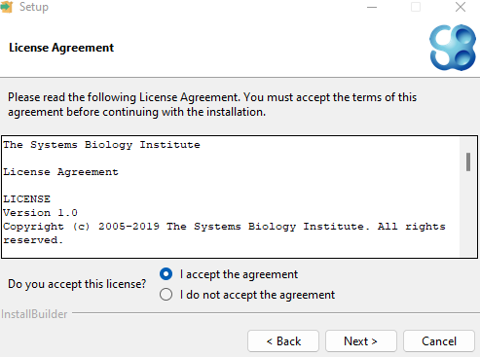
How to Install?
AMRITA
Download the installer
Go to https://www.celldesigner.org/download.html
Locate the "Windows" section and download the CellDesigner installer file (e.g., "CellDesigner-4.0.1-windows-installer.exe").
Run the installer
Double-click the downloaded installer file (e.g., "CellDesigner-4.0.1-windows-installer.exe") to start the installation process.
Follow the on-screen instructions
Choose an installation directory
Accept the license agreement, then click OK
Complete the installation
Once the installation is complete, you'll typically find a CellDesigner icon on your desktop or in the Start Menu.

Slide 4
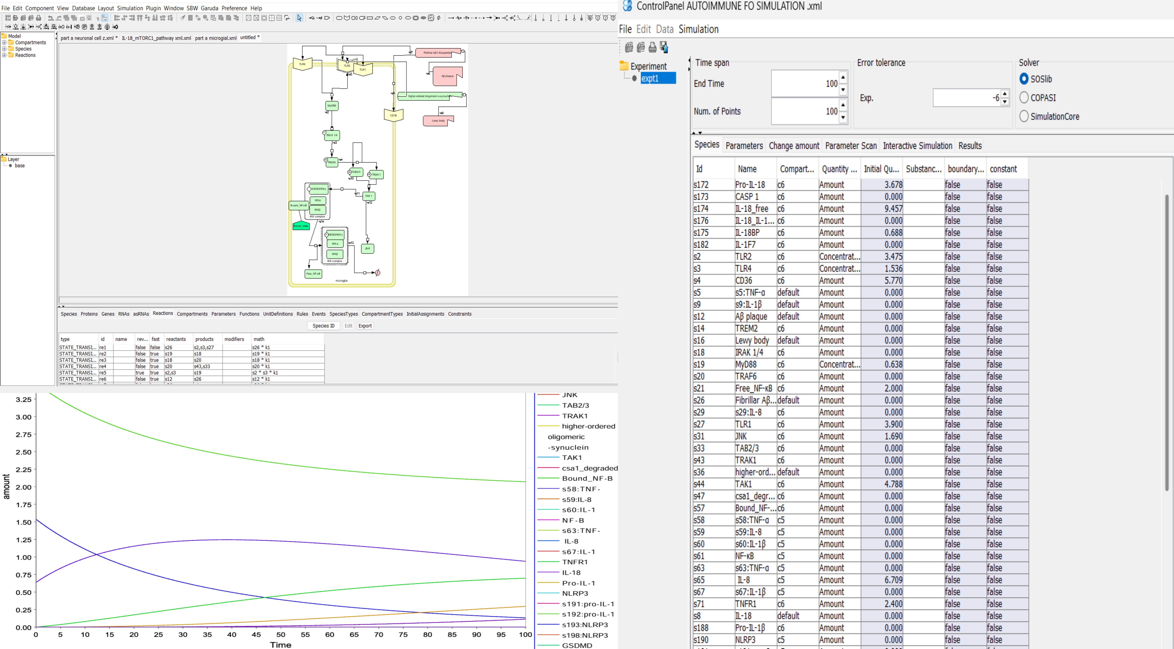
CellDesigner
AMRITA
CellDesigner is a process diagram editor for drawing gene-regulatory and biochemical networks.
Networks are drawn based on the process diagram, with graphical notation system proposed by Kitano, and are stored using the Systems Biology Markup Language (SBMLUH), a standard for representing models of biochemical and gene-regulatory networks.
Networks are able to link with simulation and other analysis packages through Systems Biology Workbench (SBW).

Slide 5

Gene Regulatory Network (GRN)
AMRITA
Intricate systems within cells that
control gene expression, ultimately dictating cellular function and responses to various stimuli.
It’s a collection of molecular regulators that interact with each other and other substances in the cell to govern the
gene expression levels of mRNA and proteins which, in turn, determine the function of the cell.

Slide 6

Easy-to-understand graphical notation (SBGN compatible)
AMRITA
Built-in simulator
(SBML ODE Solver,
Copasi)
Export of images in PNG, SVG, JPG and PDF formats
CellDesigner
Major Features
Database
connections
Intuitive user
Interface
Integration with analysis tools and other simulators via SBW 2.x
Extensive description of Compartments, Species, Reactions, and Proteins

Slide 7
CellDesigner and SBML
(Systems Biology Markup Language)
AMRITA
SBML (Systems Biology Markup Language) is a machine readable format (XML) for representing computational models in systems biology.
Its focus is to describe the systems of biochemical reactions.
Models can also include compartments, events, rules, and constraints.

Slide 8
CellDesigner and and SBGN
(Systems Biology Graphical Notations)
AMRITA
SBGN (Systems Biology Graphical Notation) is a graphical notation for representing biological interactions, such as protein-protein interactions and gene regulatory networks.
Current discussions on SBGN focus on three graphical notations: process diagram, entity relationship diagram and activity flow.
CellDesigner adopts the process diagram as its graphical notation.

Slide 9
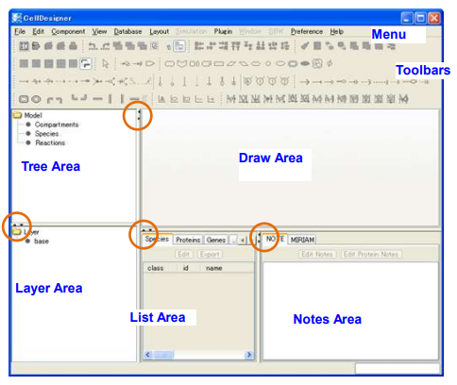
GUI: General View
AMRITA
Tree area
Displays all the list of the components in a tree structure.
Draw area
Is the area where the model is built from the tool bar items.
List area
Displays and edits the list of the components of the model (species, proteins, genes, RNAs etc).
Notes area
Displays and edits the notes of each components (reactions, proteins, complex etc.)
Layer area
Add comments to the model.

Slide 10
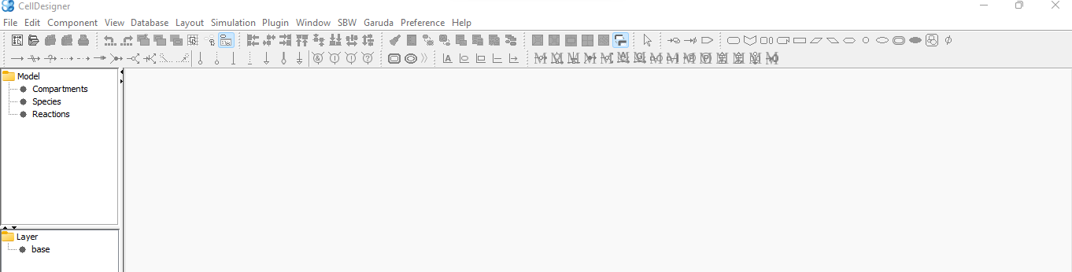
The Menu
AMRITA
Visualization Menu
Chemical Species Menu
Reaction Menu
Boolean Logic
Menu
Compartment
Menu

Slide 11
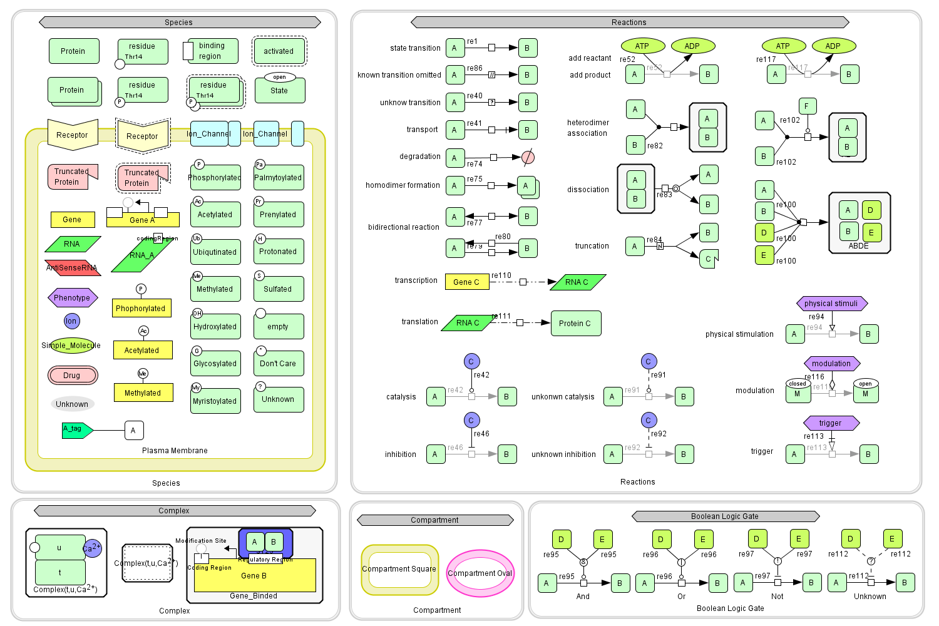
The Menu
AMRITA

Slide 12
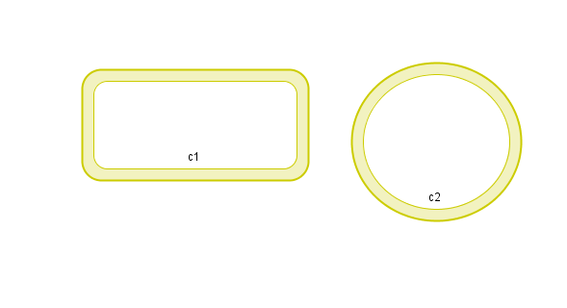
Compartments
AMRITA
Compartment can be:
Cytoplasm
Nucleus
Nucleolus
Compartment
Square
Compartment
Oval

Slide 13
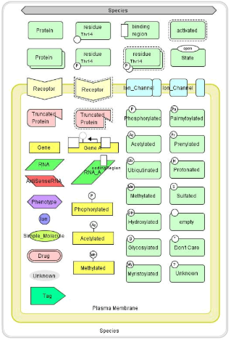
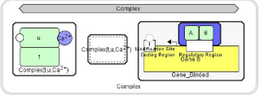
Chemical Species
AMRITA

Slide 14
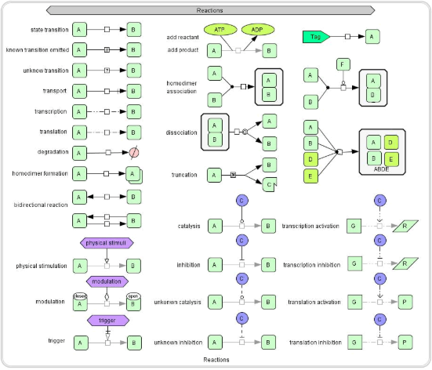
Reactions
AMRITA

Slide 15
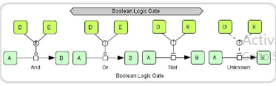
Boolean Gates
AMRITA

Slide 16
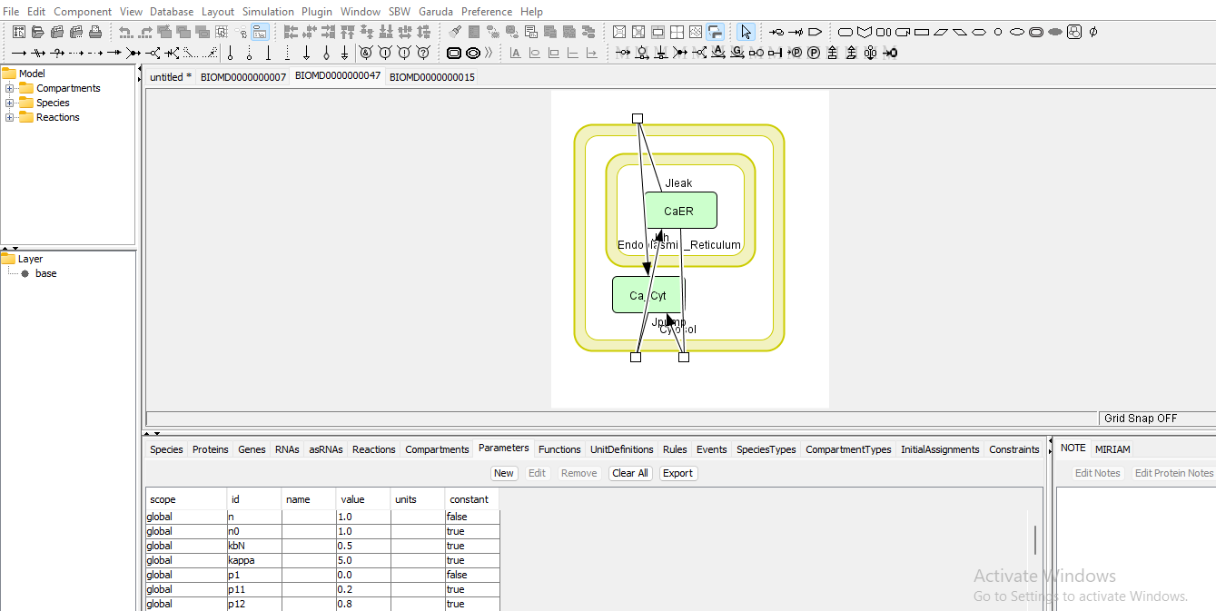
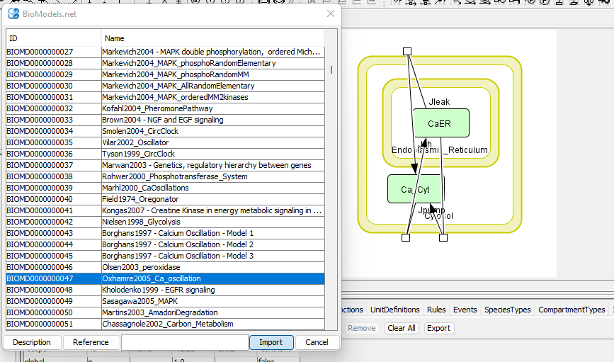
Import Models- Bacteria induced intracellular Ca2+ oscillations in epithelial cells
Boolean Gates
AMRITA

Slide 17
Boolean Gates
AMRITA
Examples to Practice

Slide 18
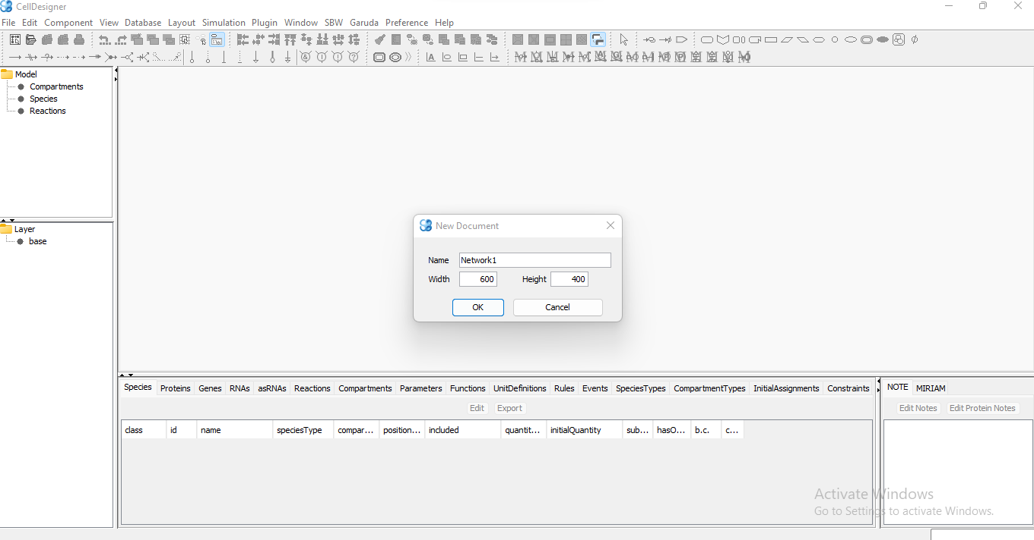
Start with a simple network
Boolean Gates
AMRITA
Open a new document:
[File]=>[New]
Name your network
Choose the dimension of the graph
(by default 600 by 400 but can be changed later)

Slide 19
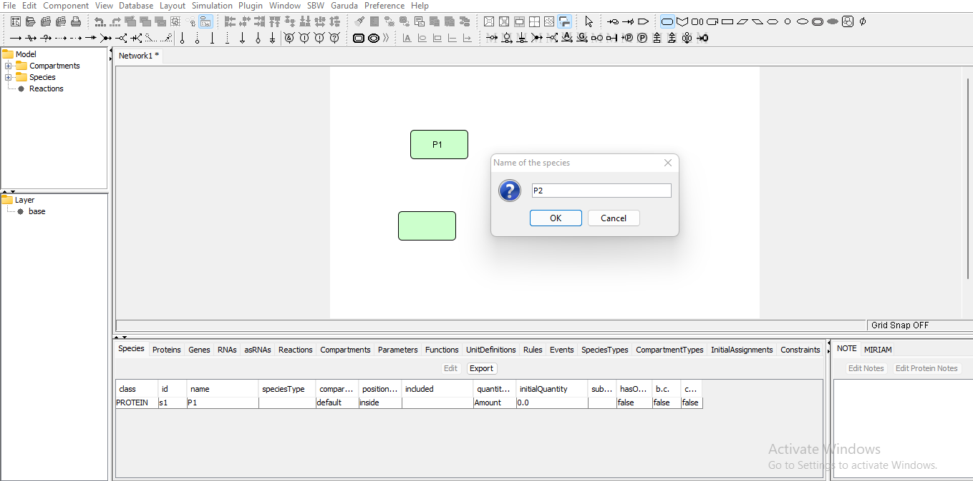
Add proteins
AMRITA
Choose to add a protein from the species menu.
Name you protein when a pop-up window opens.
Repeat the process as many times as needed.

Slide 20
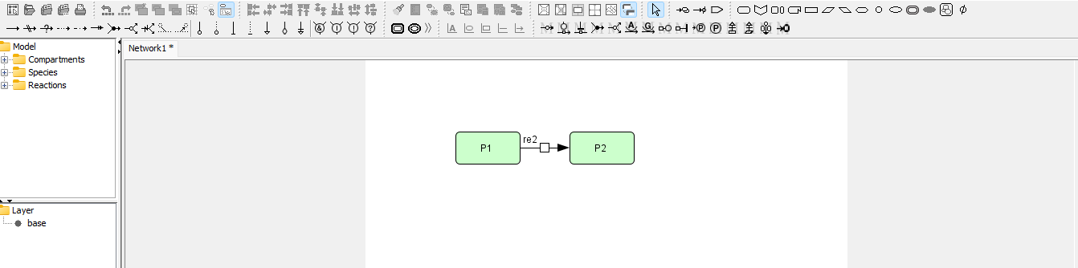
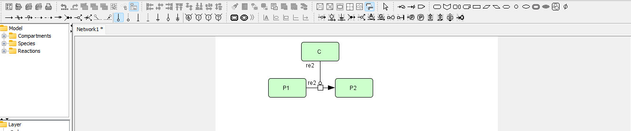
Create a Reaction
AMRITA
Draw a state transition arrow from P1 to P2.
Draw a state transition arrow from P1 to P2.
Add catalyst

Slide 21
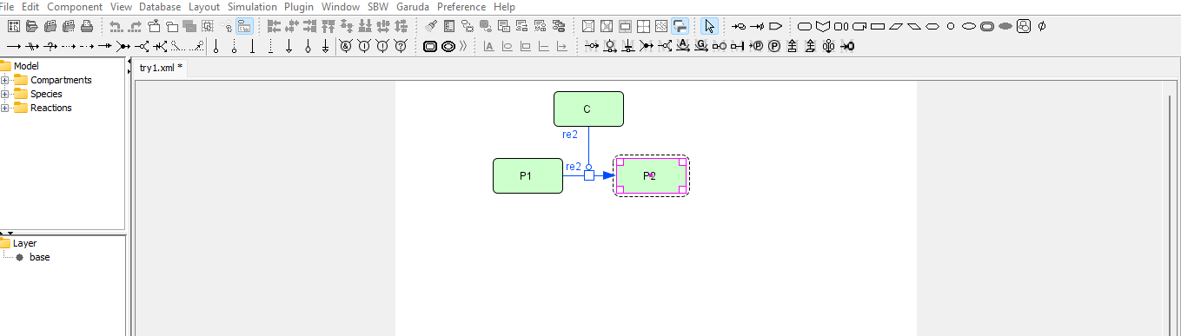
Set Active State
AMRITA
The active state is the region of an enzyme where substrate molecules bind and undergo a chemical reaction.
Select protein P2 and click “Component->set active A”.

Slide 22
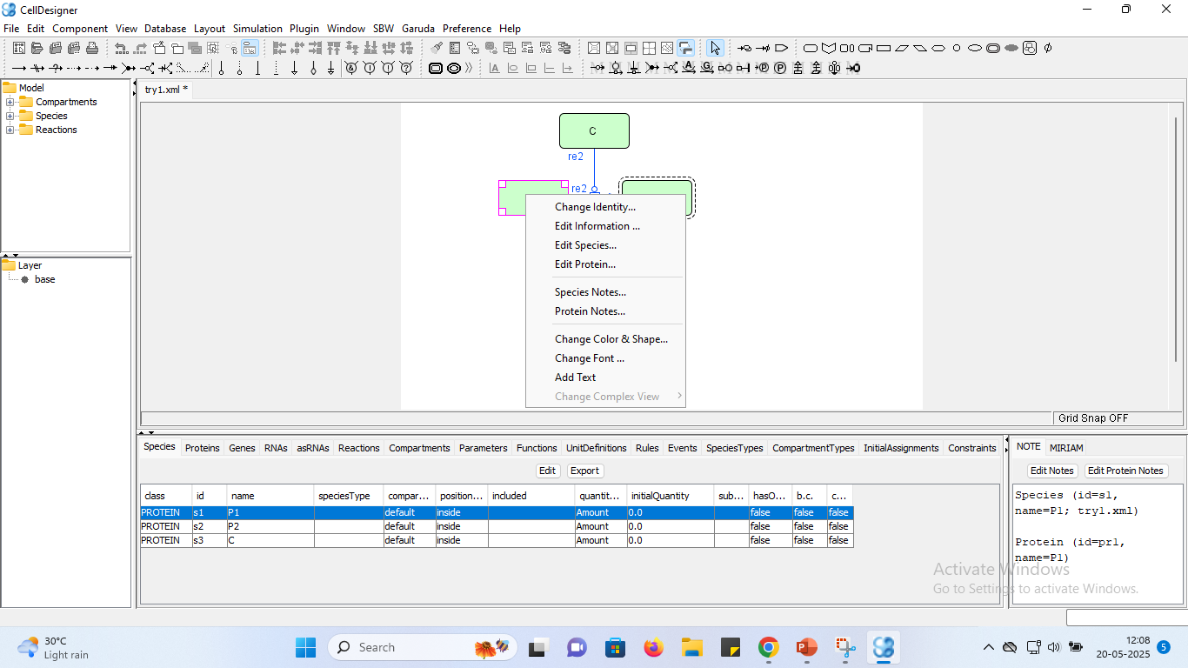
Change Details
AMRITA
Right click on an element
(e.g. protein P1) and change whatever you want.

Slide 23
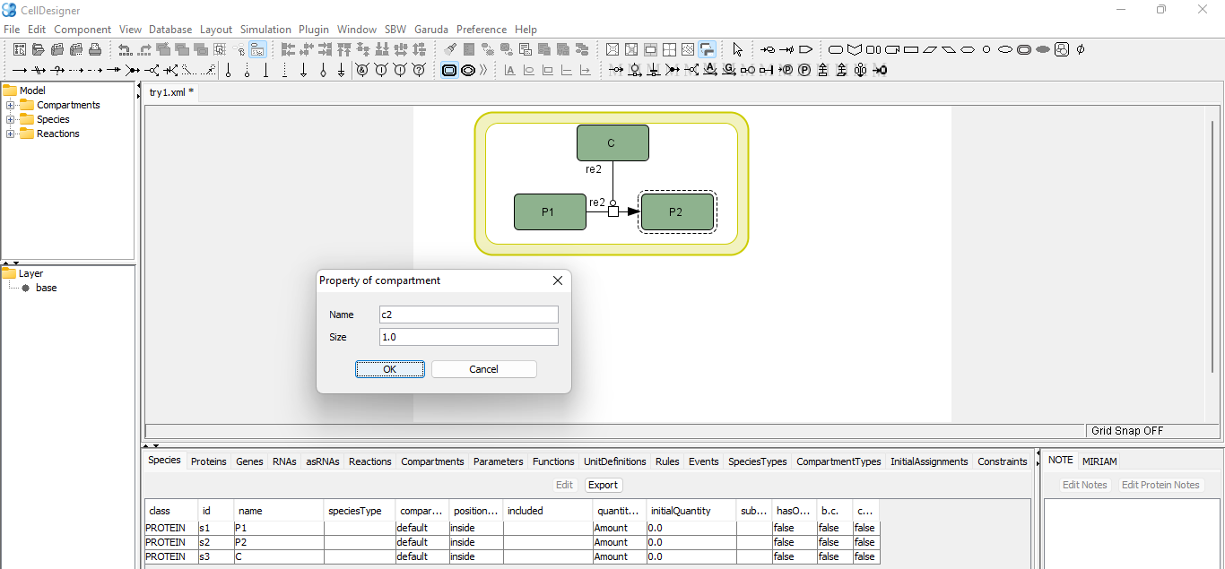
Create Compartment
AMRITA

Slide 24
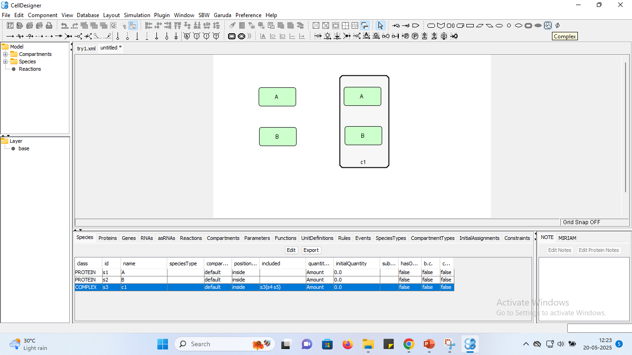
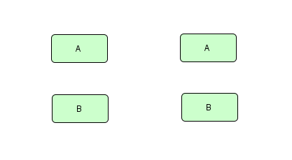
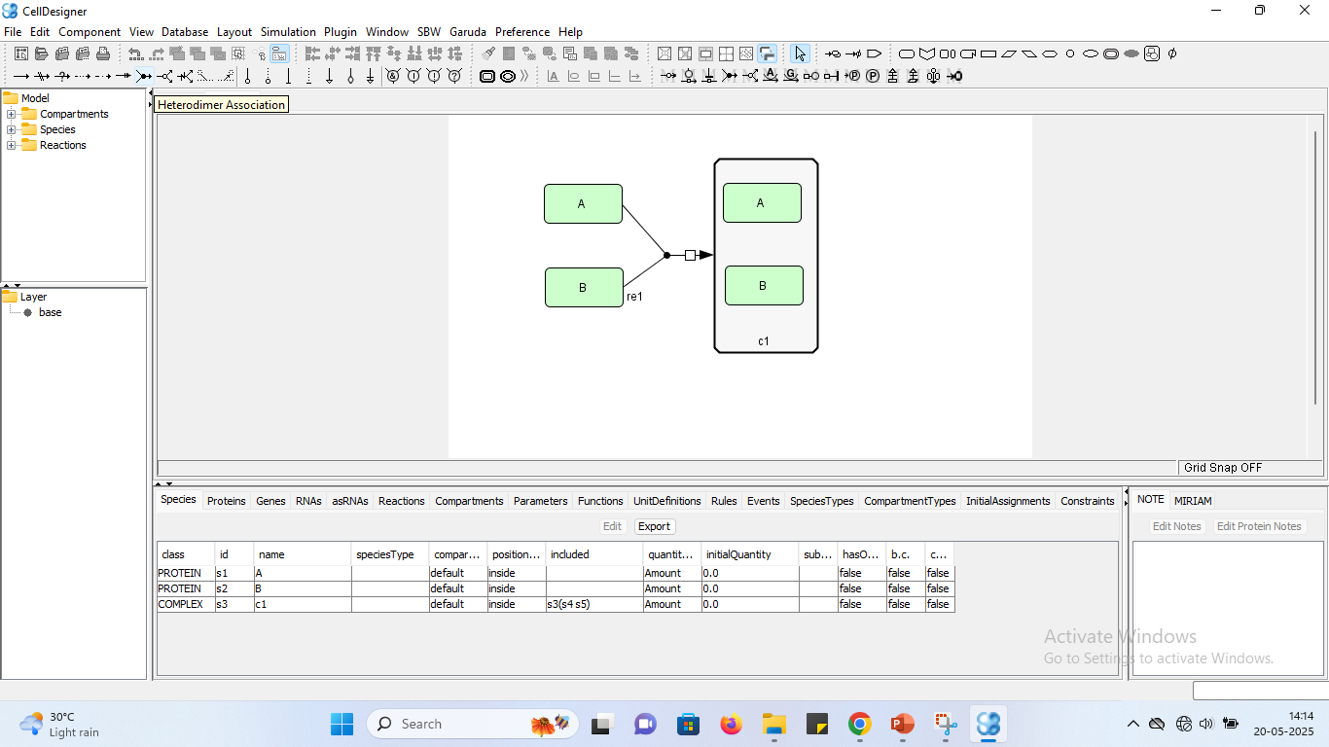
Draw a complex around proteins A and B.
Create Complex
AMRITA
Create a new model with proteins A and B.
Draw heterodimer association arrow from A to B
to complex A and B.

Slide 25
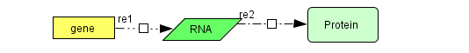
Gene and RNA
AMRITA
Create a new model
Create gene, RNA, and protein
Draw transcription between gene and RNA.
Draw translation between RNA and protein.

Slide 26
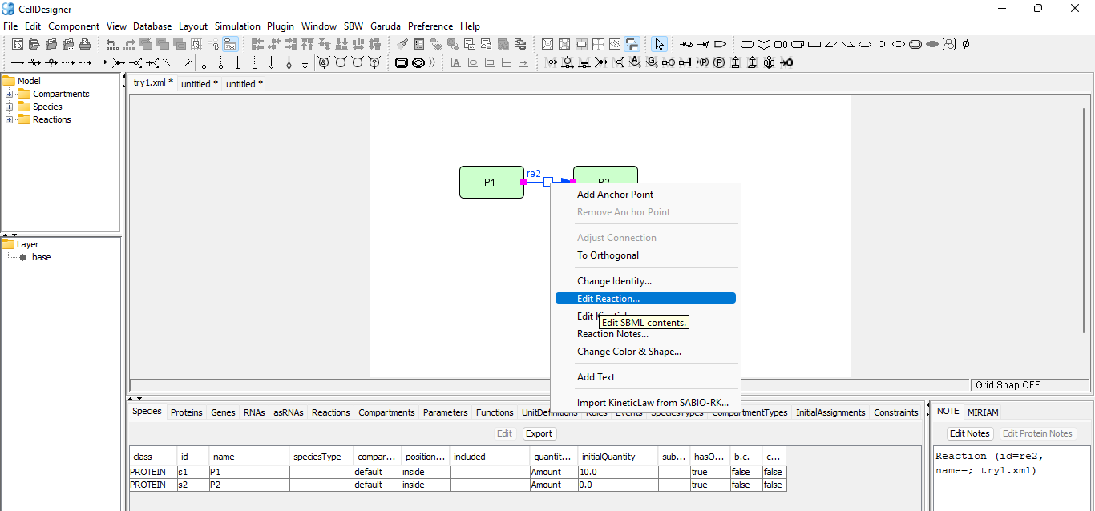
Simulation
Create the following biochemical reaction.
The equation is
d[P2]/dt=k[P1]. Where, k=0.3, P1=0.1, P2=0.
AMRITA
Right click on reaction and select “Edit kinetic law”.

Slide 27
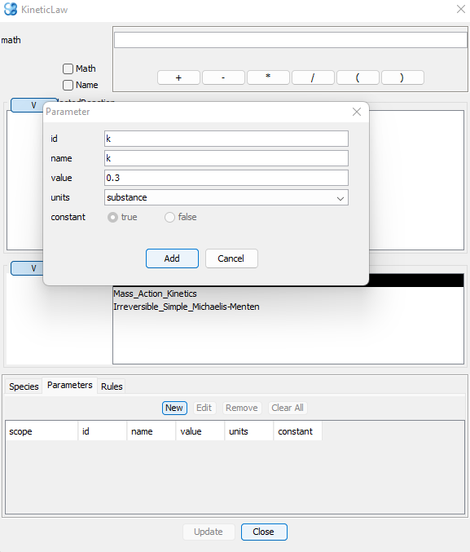
Simulation
AMRITA
Click on parameter tab “New” and type the following details.
Click Add.

Slide 28
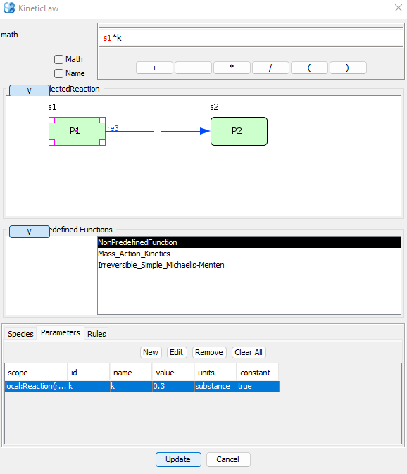
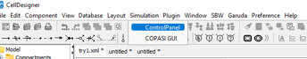
Simulation
AMRITA
Select parameter “k” and type in the top text field.
Click update and close the window.
Navigate to simulation->control panel

Slide 29
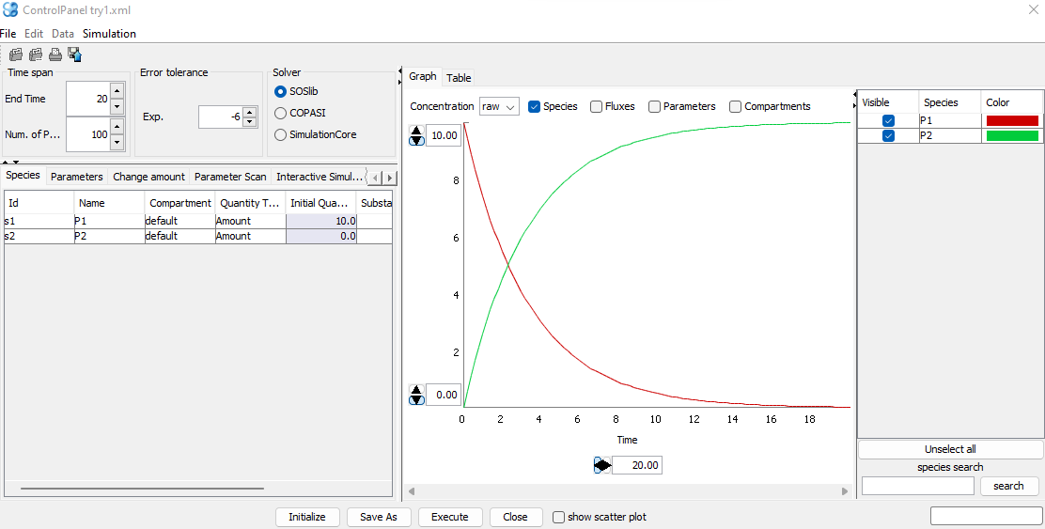
Simulation
AMRITA
Type 20 in end time and click execute.

Slide 30
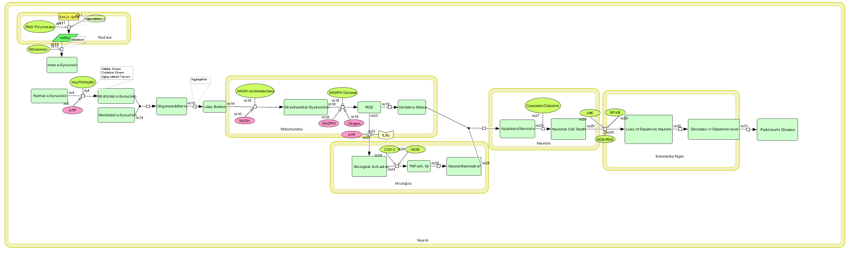
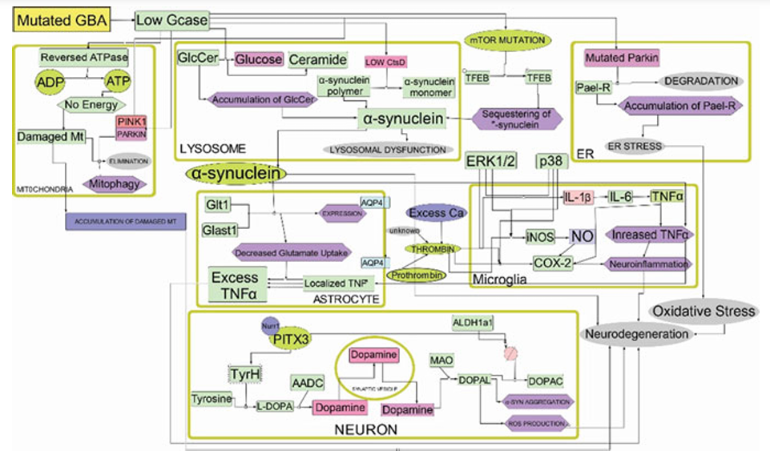
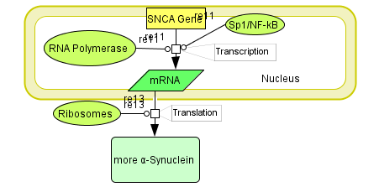
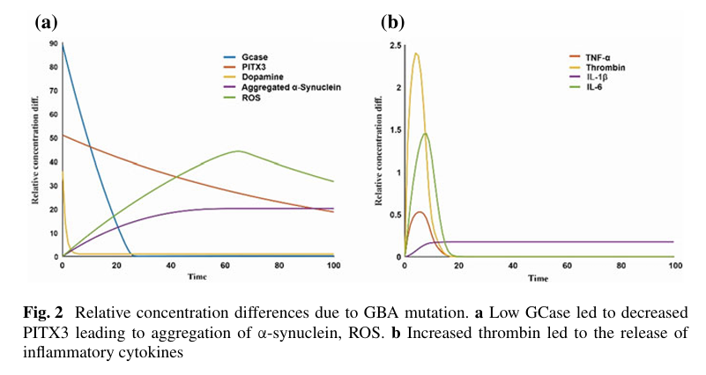
Our Work-Disease pathway in patients
AMRITA

Slide 31
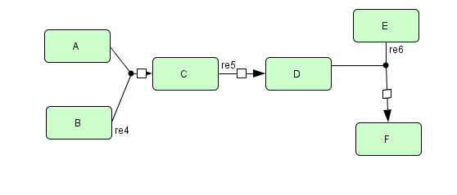
Exercise- Model a biochemical reaction and simulate
AMRITA
K3*D
K3=0.6
K1*A*B
K1=30
K2*C
K2=0.01
A=0.5
B=0.2
C=0.01
D=0.02
E=0.0
F=0.0

Slide 32


AMRITA

